Slide 1
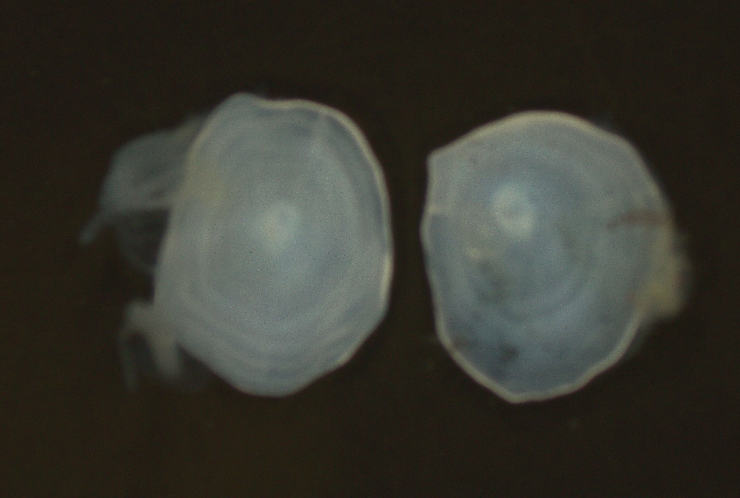
Taking Good Pictures
Otoliths from commercial fish species aged in the Gulf region can be either:
Whole – Embedded or not embedded
-or-
Sectioned – Embedded or not embedded

Slide 2
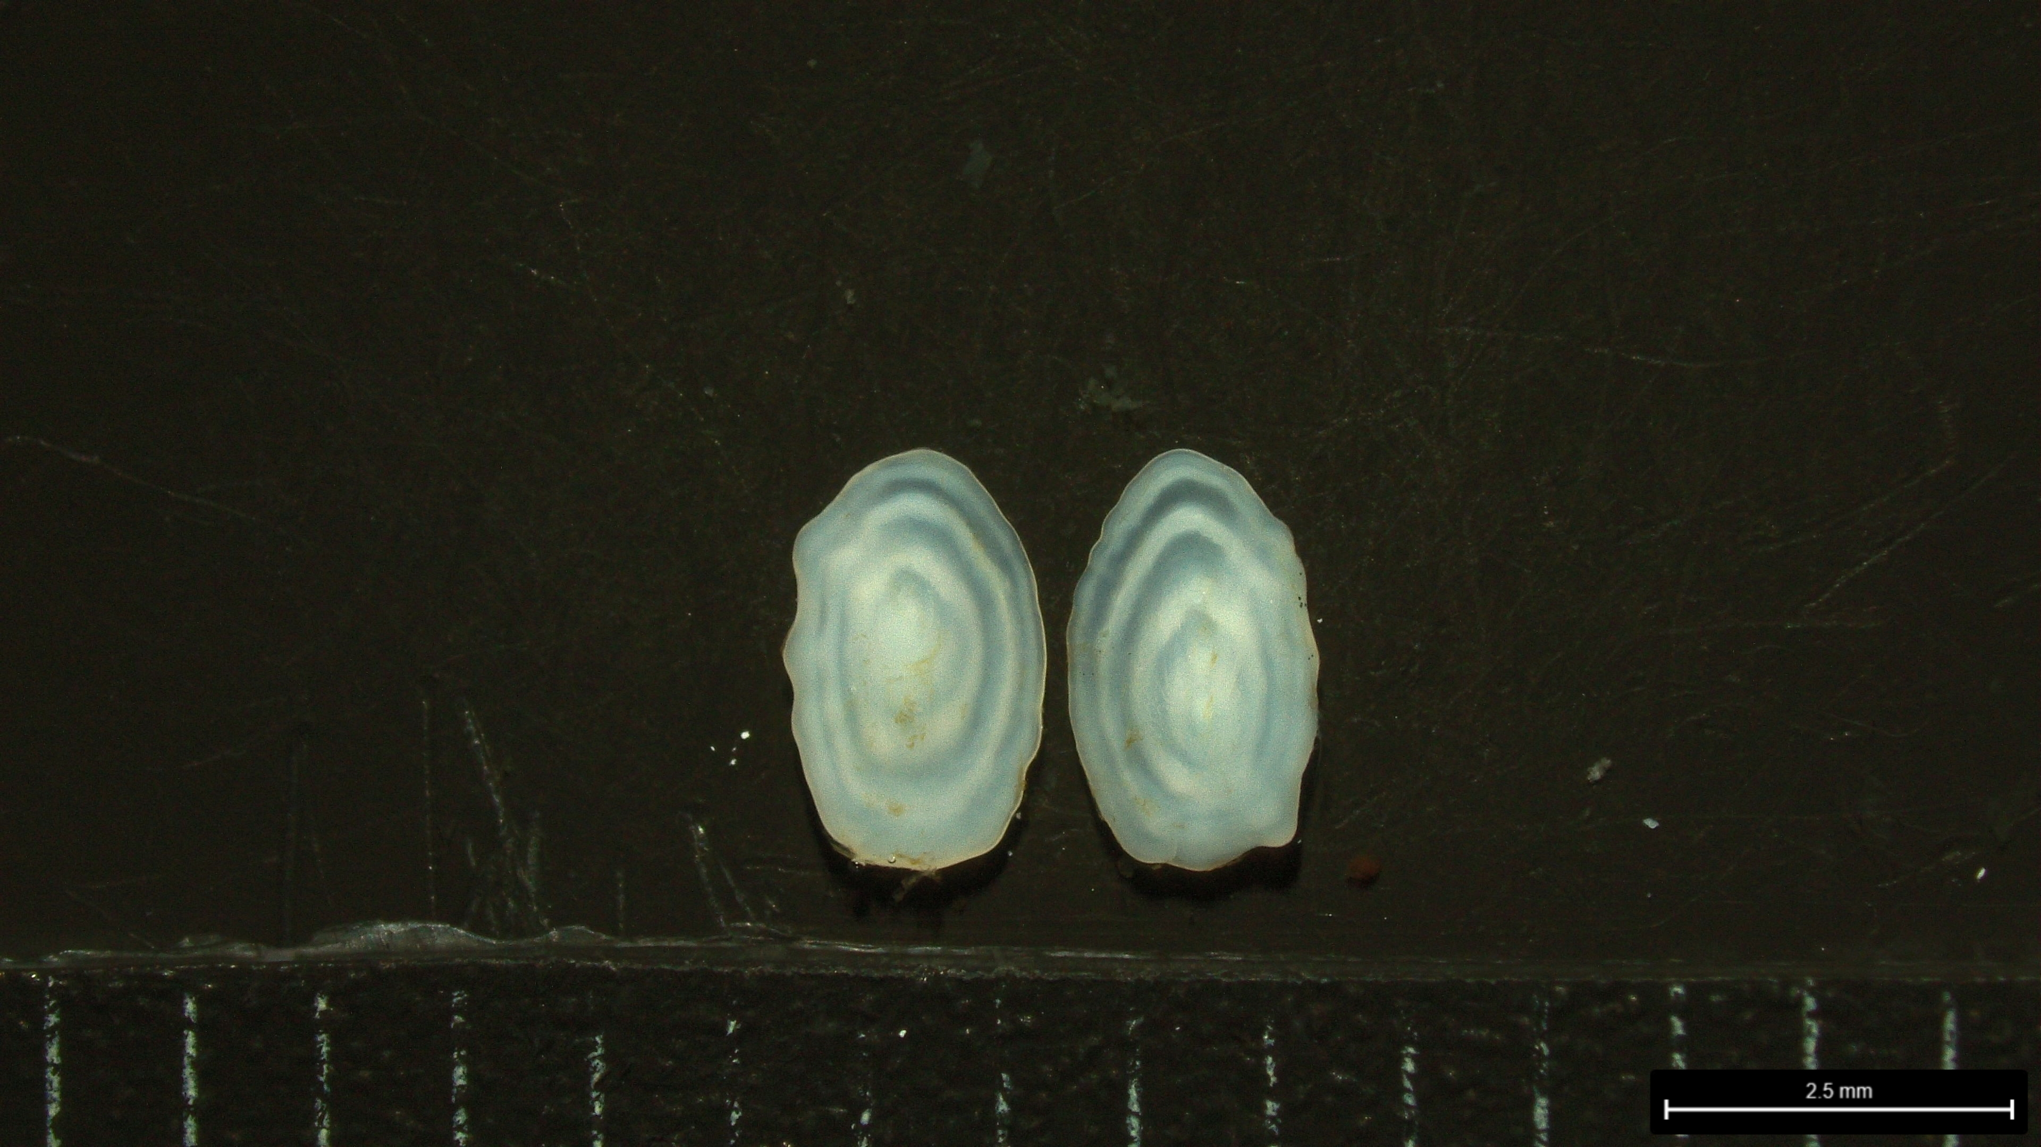
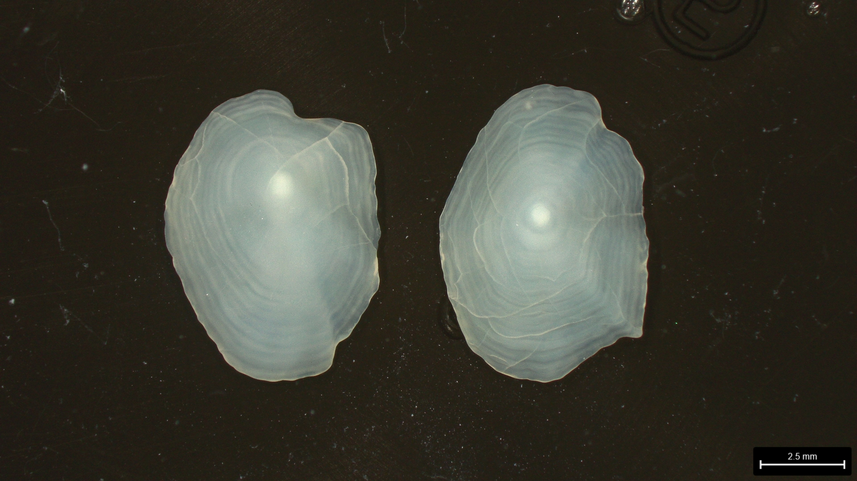
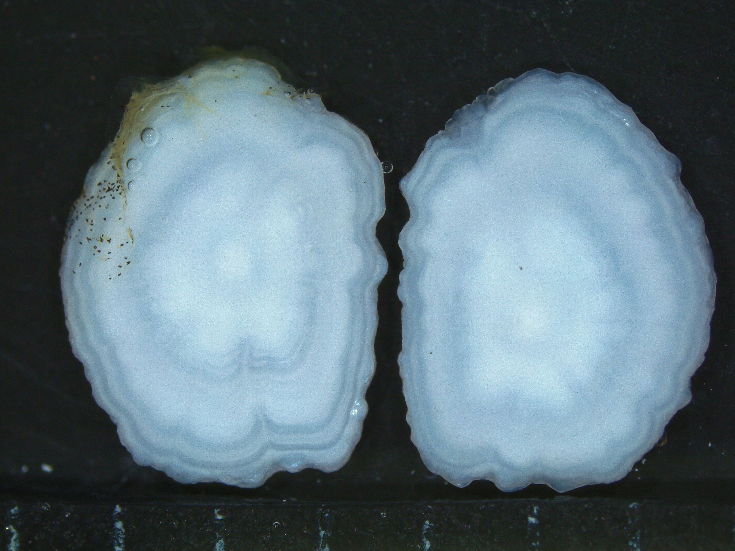
Whole Otoliths
Winter flounder
American plaice
Yellowtail flounder
Atlantic Herring (embedded)
Leica S9i using LASx software (since 2020)
ImagePro (since 2006)

Slide 3
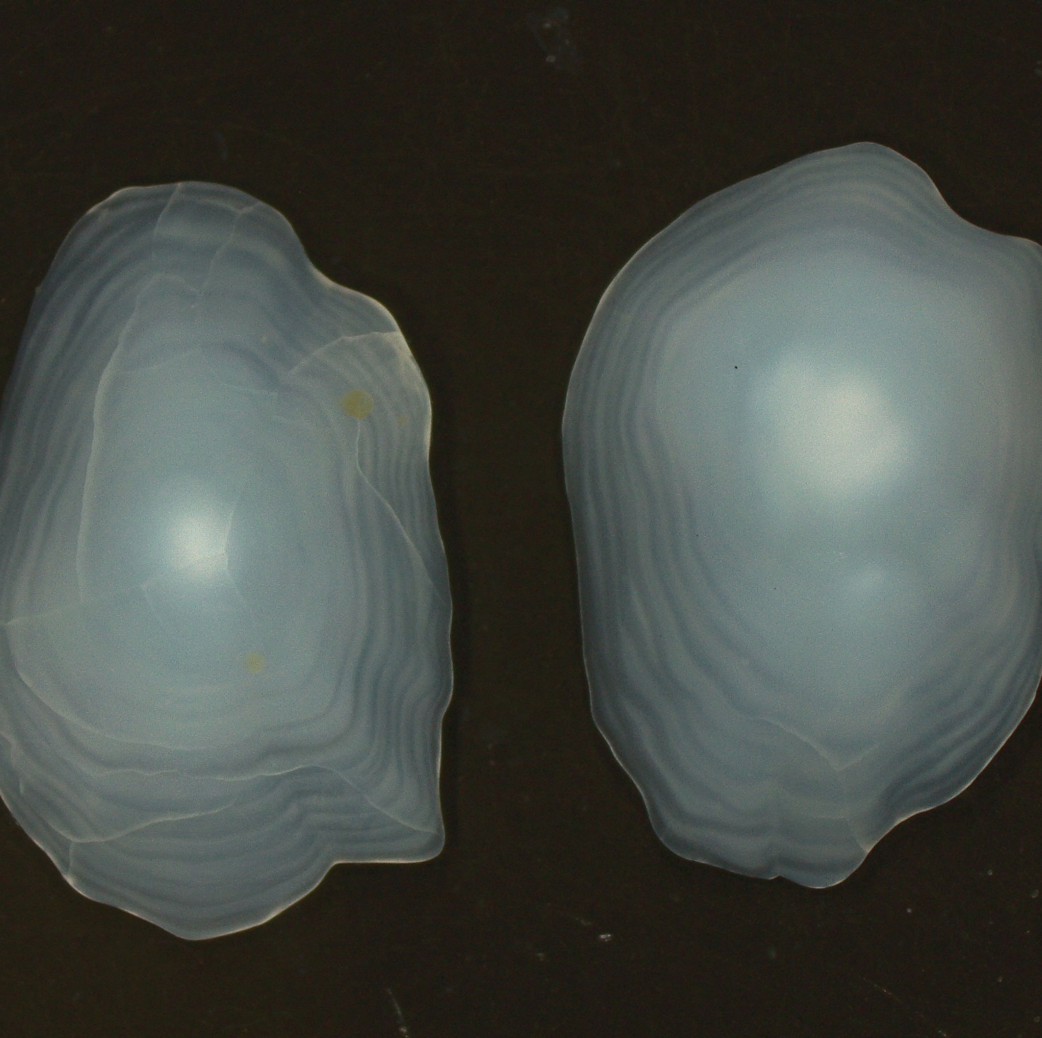
We follow these basic guidelines when photographing whole otoliths
Take against dark background
Submerged in liquid
Reflected light from above
Minimize glare
Orientation – Distal side, proximal side
Magnification of 10x

Slide 4
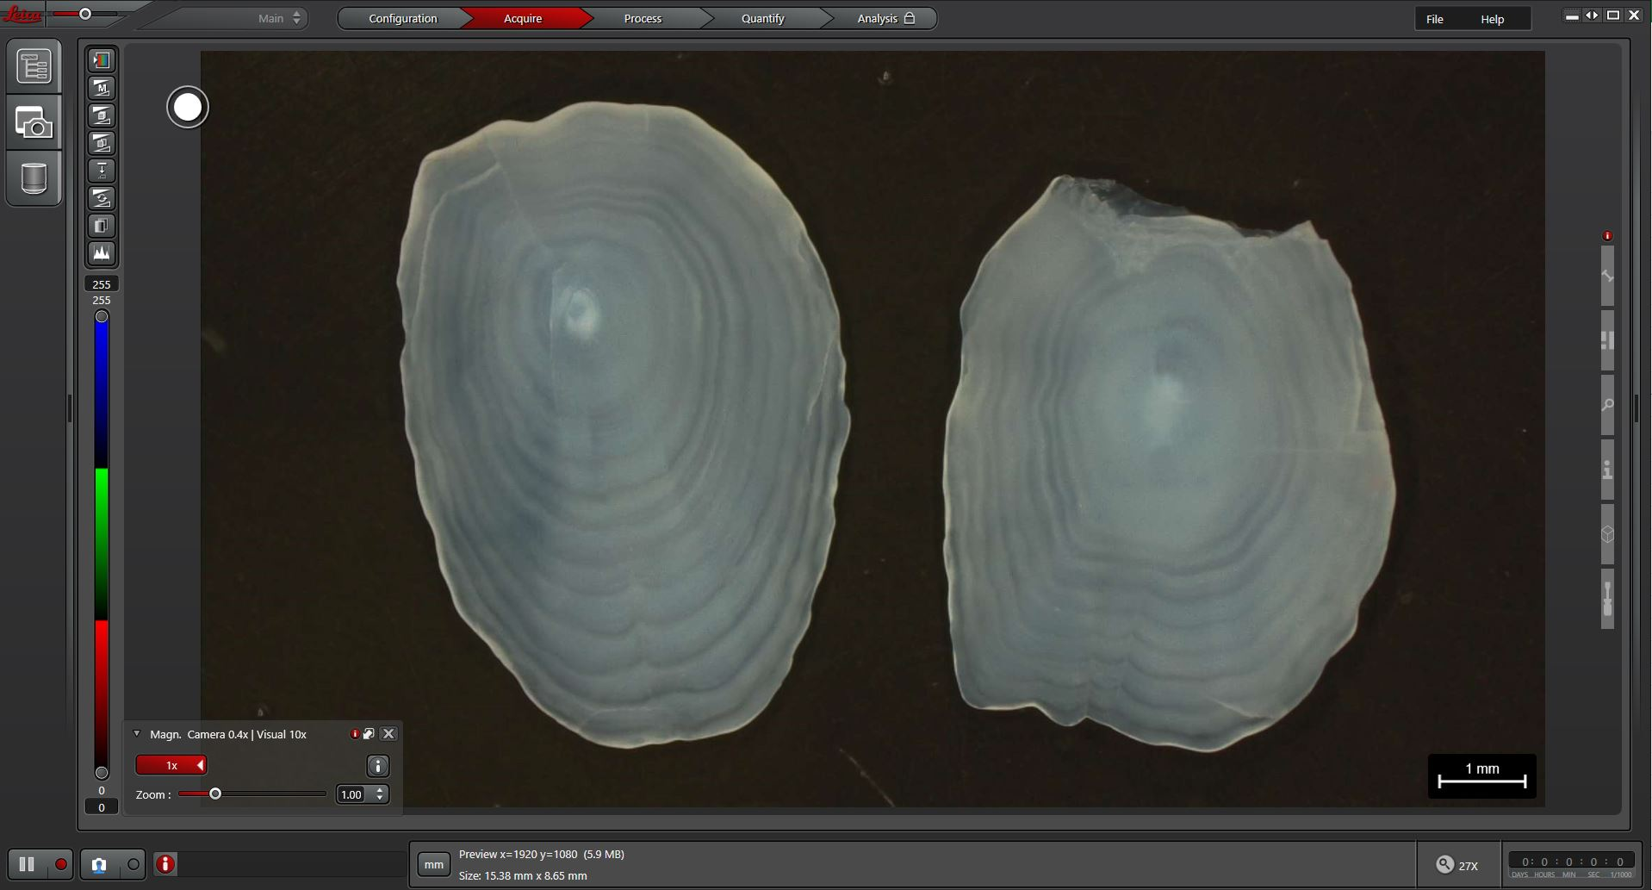

Slide 5
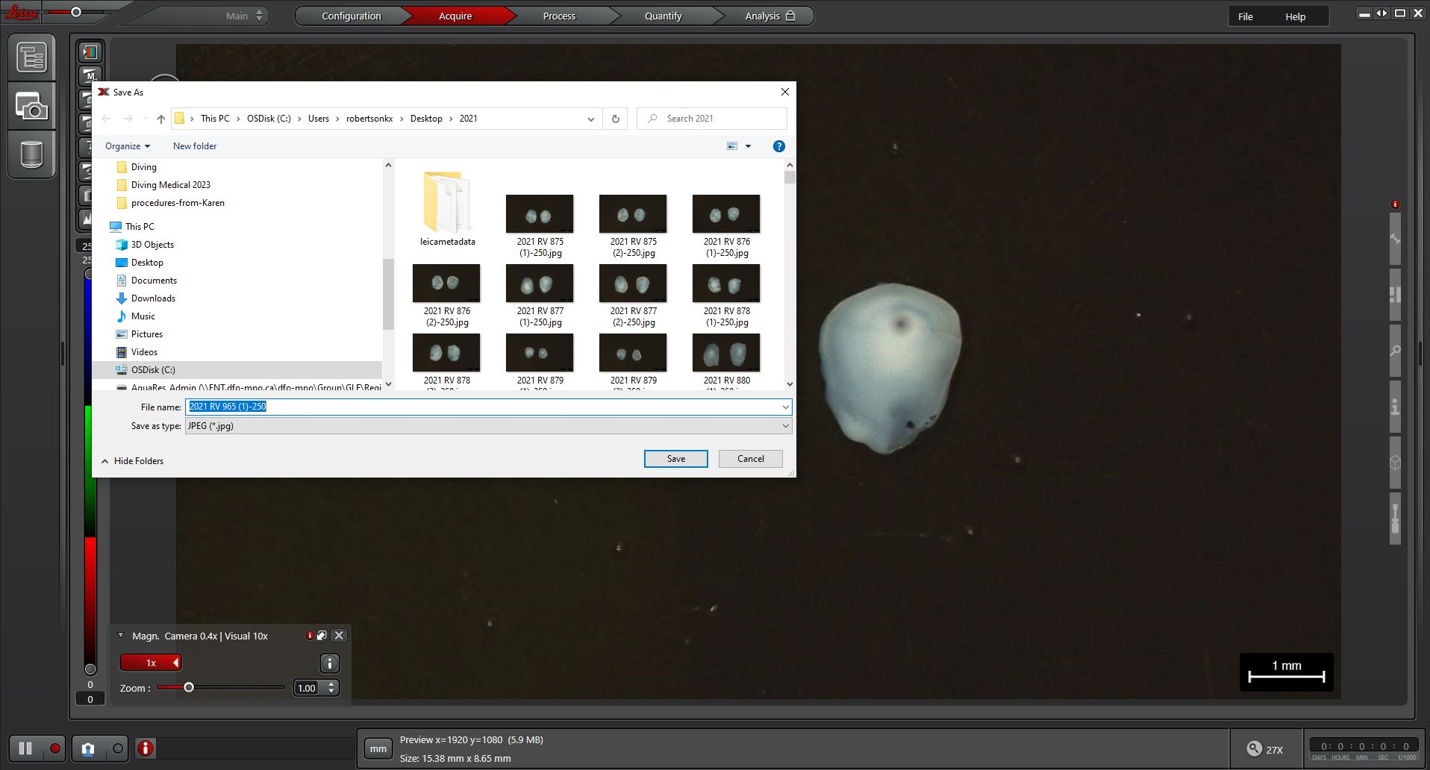
**** Very Important Step
Include: Year, Survey, Fish #, Photo #1 & 2, scale

Slide 6
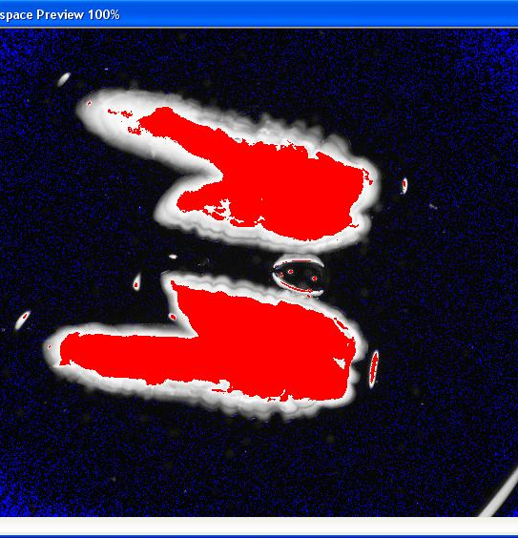
Herring Otoliths
Set magnification of 20x
Calibrate the camera
Add water to each of the wells of the otolith tray flush with the edges (no convex or concave)
Place tray under microscope. The tray needs to be oriented so that the rostrum points to the left
Focus the image, adjust the light so there is no glare (we use a saturation warning preview) and snap the photo
Save with year, sample #, fish #
Enhancements of photos are also done using ImagePro and then a batch script using GIMP

Slide 7
Original Photo
Enhanced Photo

Slide 8
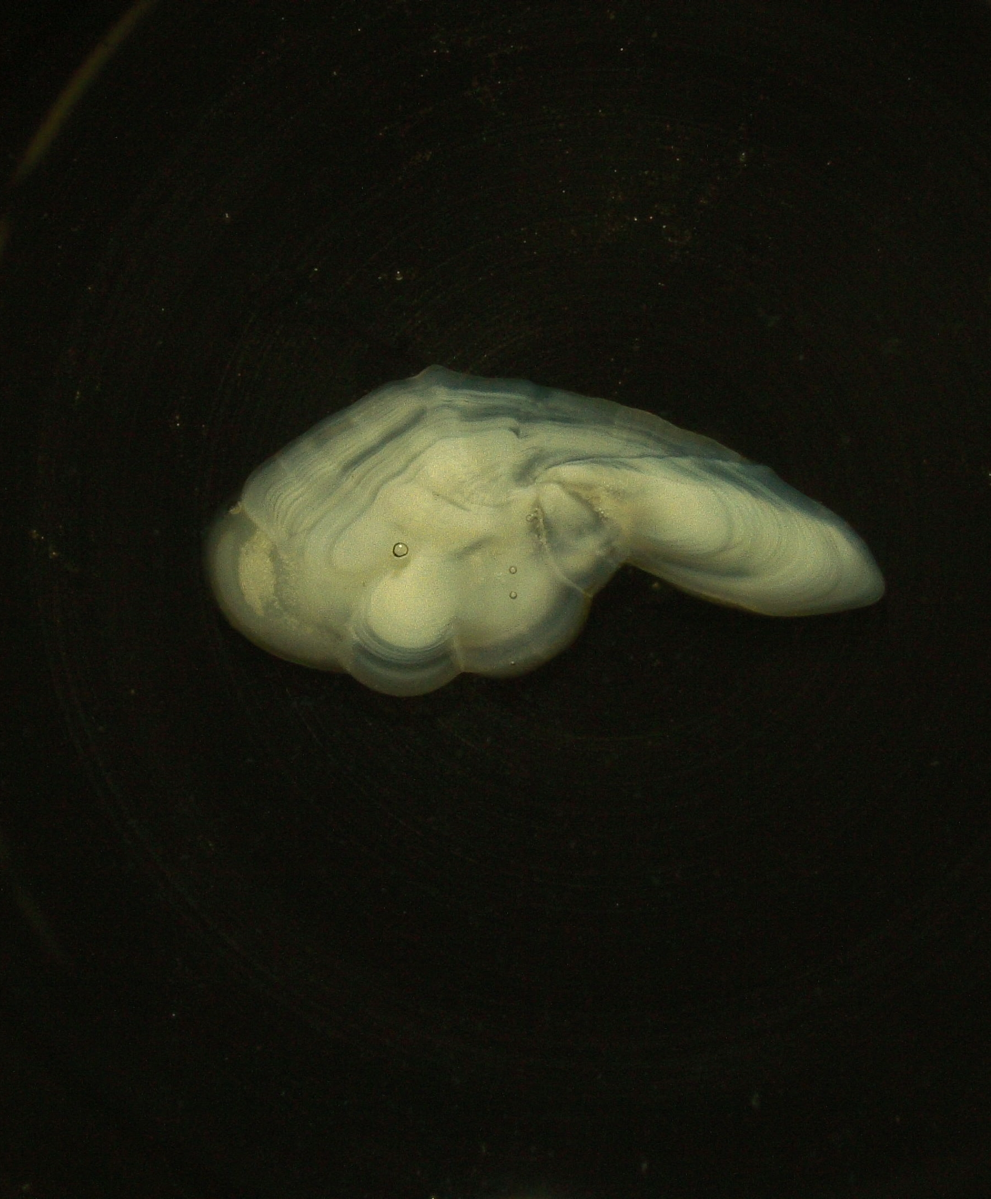
Sectioned Otoliths
Use LASX Leica s9i, same microscope/camera set up used for whole otoliths
White Hake
Atlantic Cod (have yet to photograph)
Witch Flounder (have yet to photograph)
Dark background, reduce glare
Take 1 photo/section
Magnification of 10x
Notes:
White Hake
Digital Reference collection
No annotations in Smartdots yet
Historically embedded into black trays (1 otolith/well) and aged from the tray. Now eliminating the embedding process and photographing the sections
Atlantic Cod
No photos taken – digitize reference collection
Witch Flounder
No photos taken – establish reference collection, digitize

Slide 9

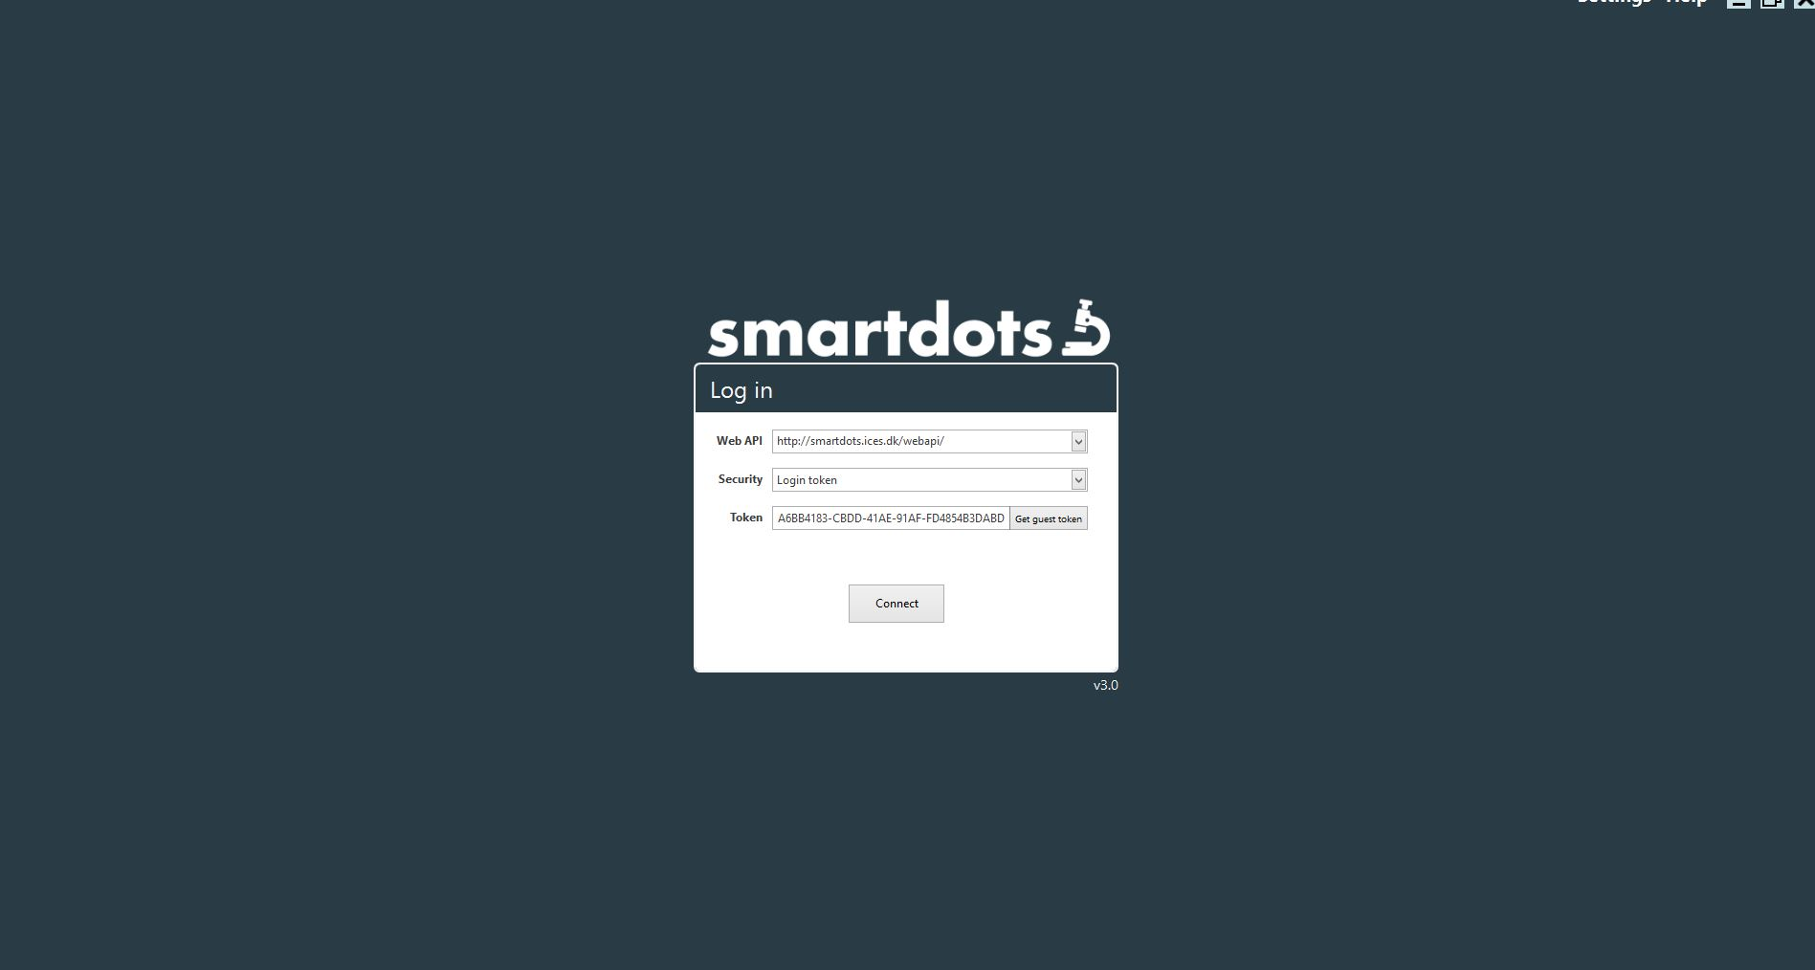
Annotations in Smartdots
Smartdots is a platform that facilitates reading, exchanges, workshops and training events of biological structures from images
Request an account, get log in tokens
Create an event
Upload photos
Add agers/delegates
Create annotations
Create report

Slide 10
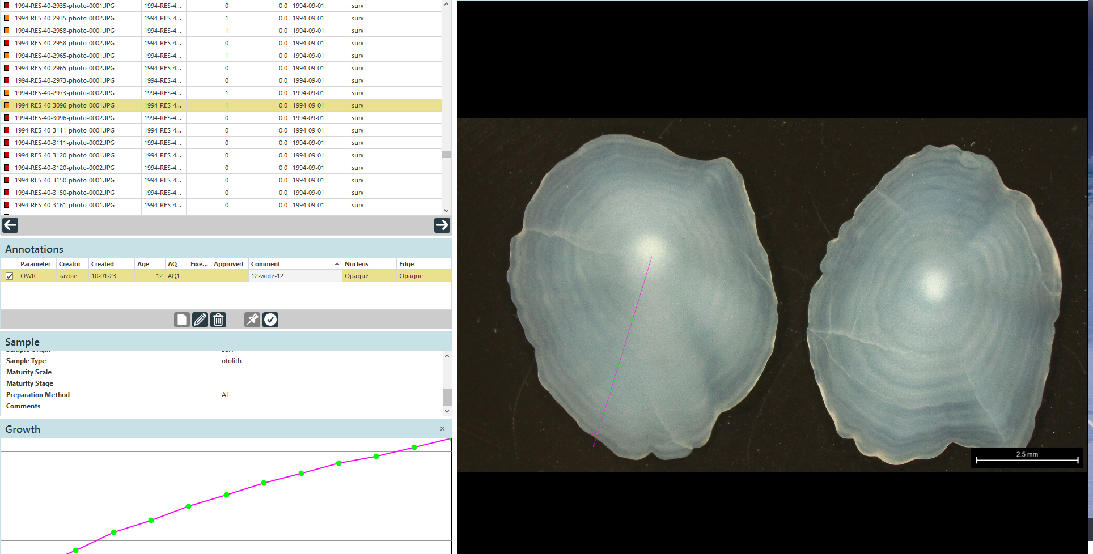

Slide 11
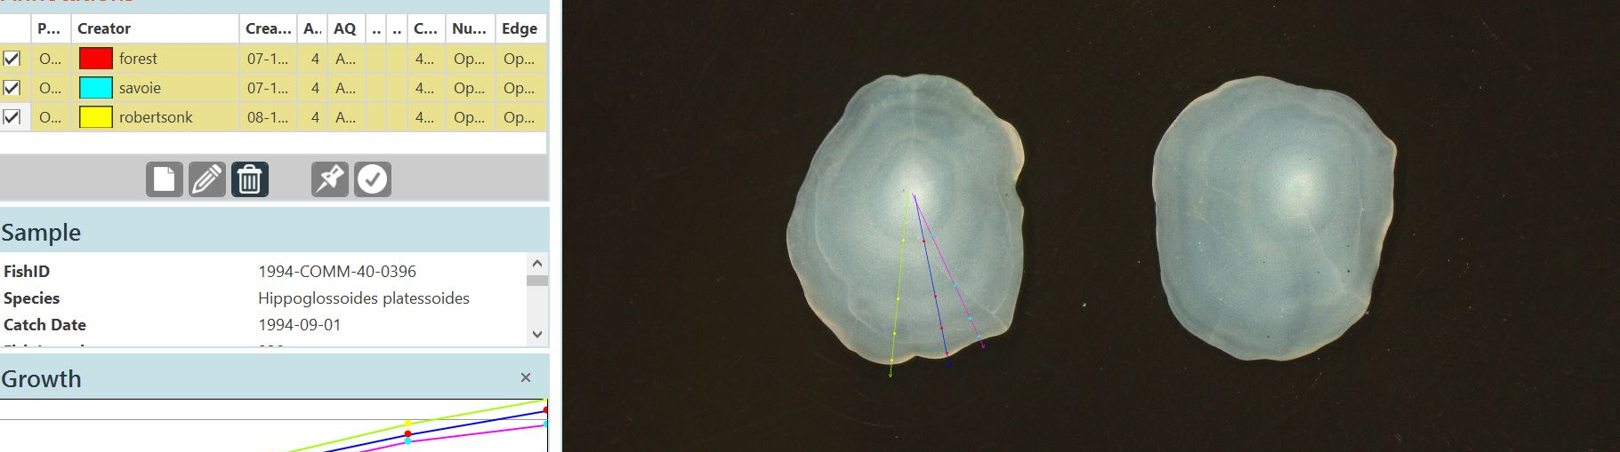

Line should be drawn along the longest growth axis (or where annuli are most defined)
Add dots to the end of the winter growth (“dark” or translucent bands) –keep consistent placement for growth calculations
Zoom in to see the smaller annuli
Note the annuli at the edge – only put dots on true/complete annuli
Notes:
Add edge type explanation

Slide 12
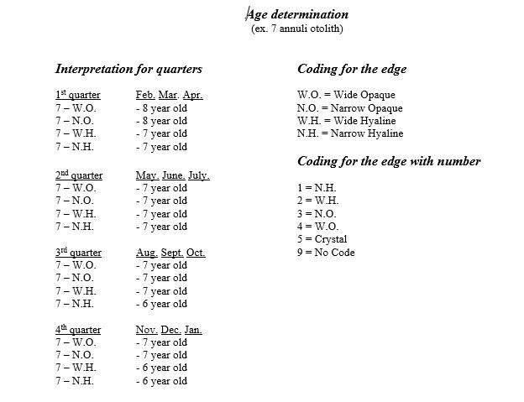
Edge Types
Assume birthday of January 1st
Note the date (month) of capture
Determine if edge is:
Opaque (white) or Translucent/Hyaline (dark/clear)
Wide or Narrow
Subtract 1 year, Add 1 year, or Remain the same
Notes:
REMOVE SLIDE??

Slide 13
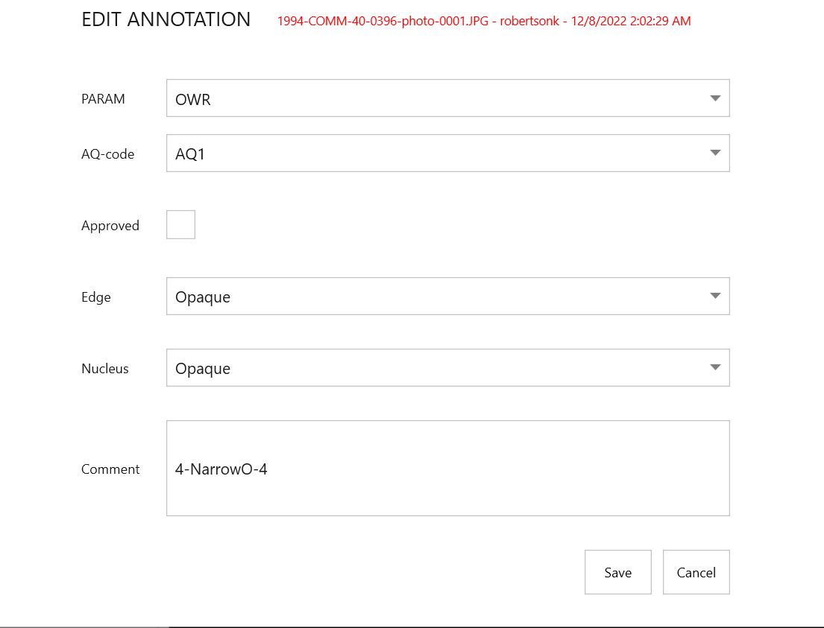
Add details about otolith
AQ-code – the “readability” of the otolith
1=rings counted clearly
2=rings counted with difficultly & doubt
3=rings can NOT be counted
3_QA=unreadable or very difficult to read
Edge – Opaque or Translucent
Nucleus – Opaque or Translucent
Comment – 4(# of annuli)-NarrowO (edge type code)-4(age)
Approve the annotation

Slide 14
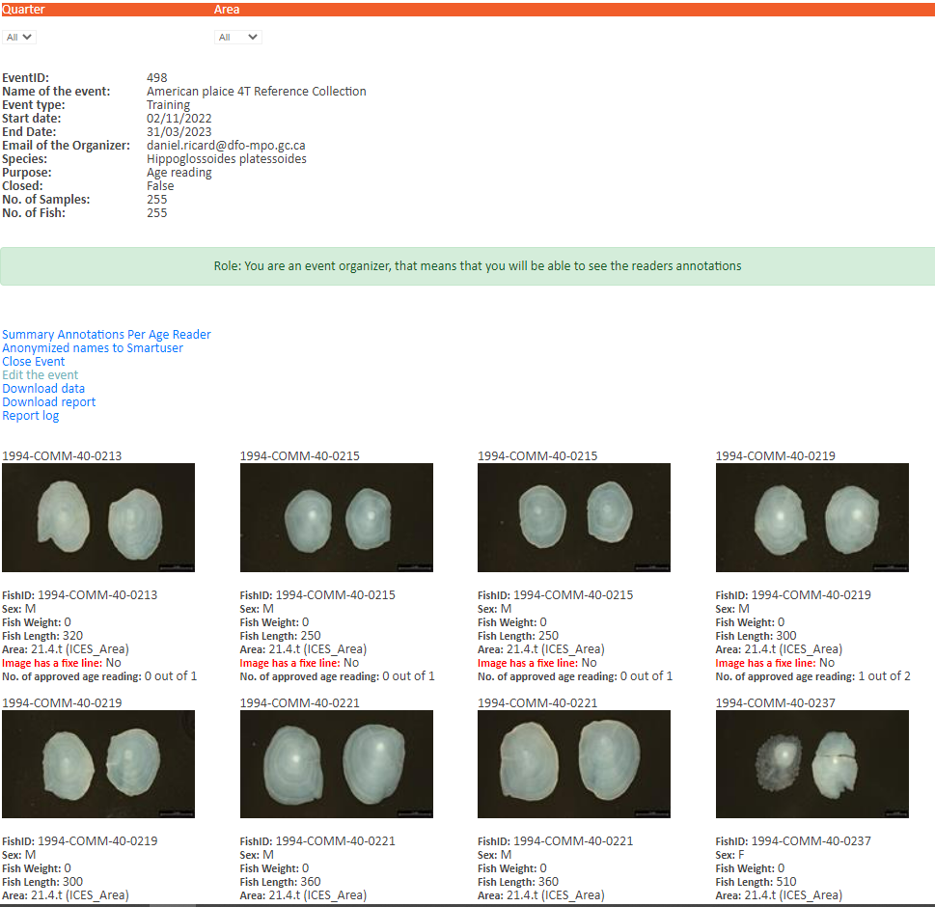
Creating a Report

